Slide 1

R Visualization Carpentries @ Stanford
Stanford Libraries
10/15/2021

Slide 2
Agenda
Part I - Basic plots: scatter plots, box plots, bar graphs, line plots, violin plots, histograms, formatting data
Part II - Organization: grouping, coloring, faceting, ordering
Part III - Aesthetics: legend, title, axes, ticks, themes; saving plots
Q&A

Slide 3
Before we begin
# install ggplot2
> install.packages("ggplot2”)
> library(ggplot2)
# load diamonds dataset
> data(diamonds)
> diamonds

Slide 4
Basic syntax for ggplot2
ggplot(data = <DATA>, mapping = aes(<MAPPINGS>)) + <GEOM_FUNCTION>()

Slide 5
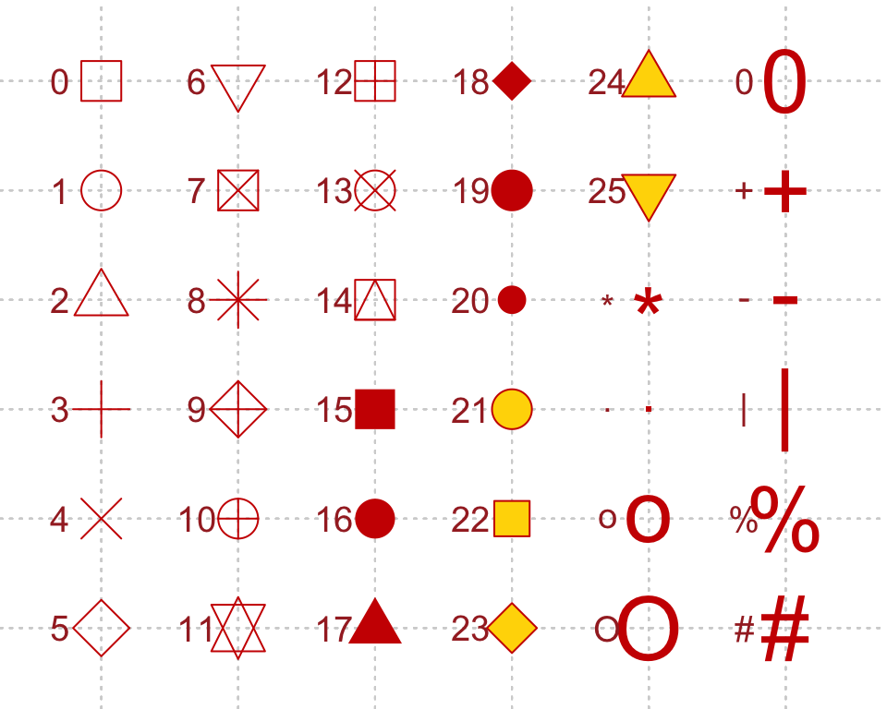
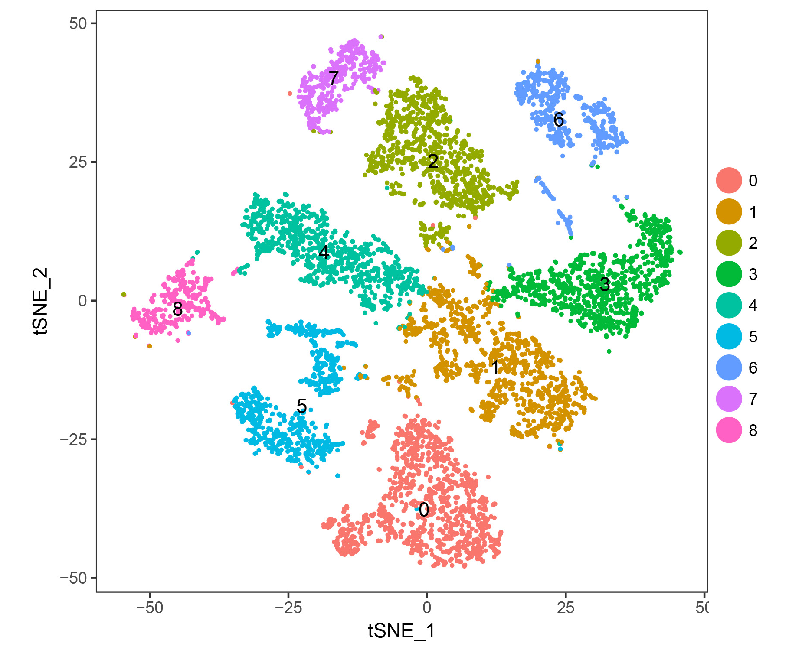
Scatter plot
ggplot(data = <DATA>, mapping = aes(<MAPPINGS>)) + geom_point()

Slide 6
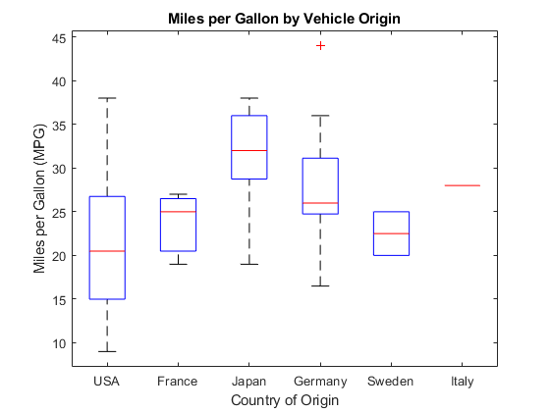
Boxplot
ggplot(data = <DATA>, mapping = aes(<MAPPINGS>)) + geom_boxplot() + geom_jitter()

Slide 7
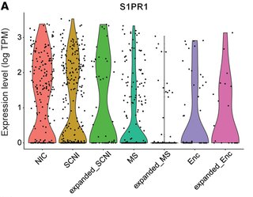
Violin plot
ggplot(data = <DATA>, mapping = aes(<MAPPINGS>)) + geom_violin() + geom_jitter()

Slide 8
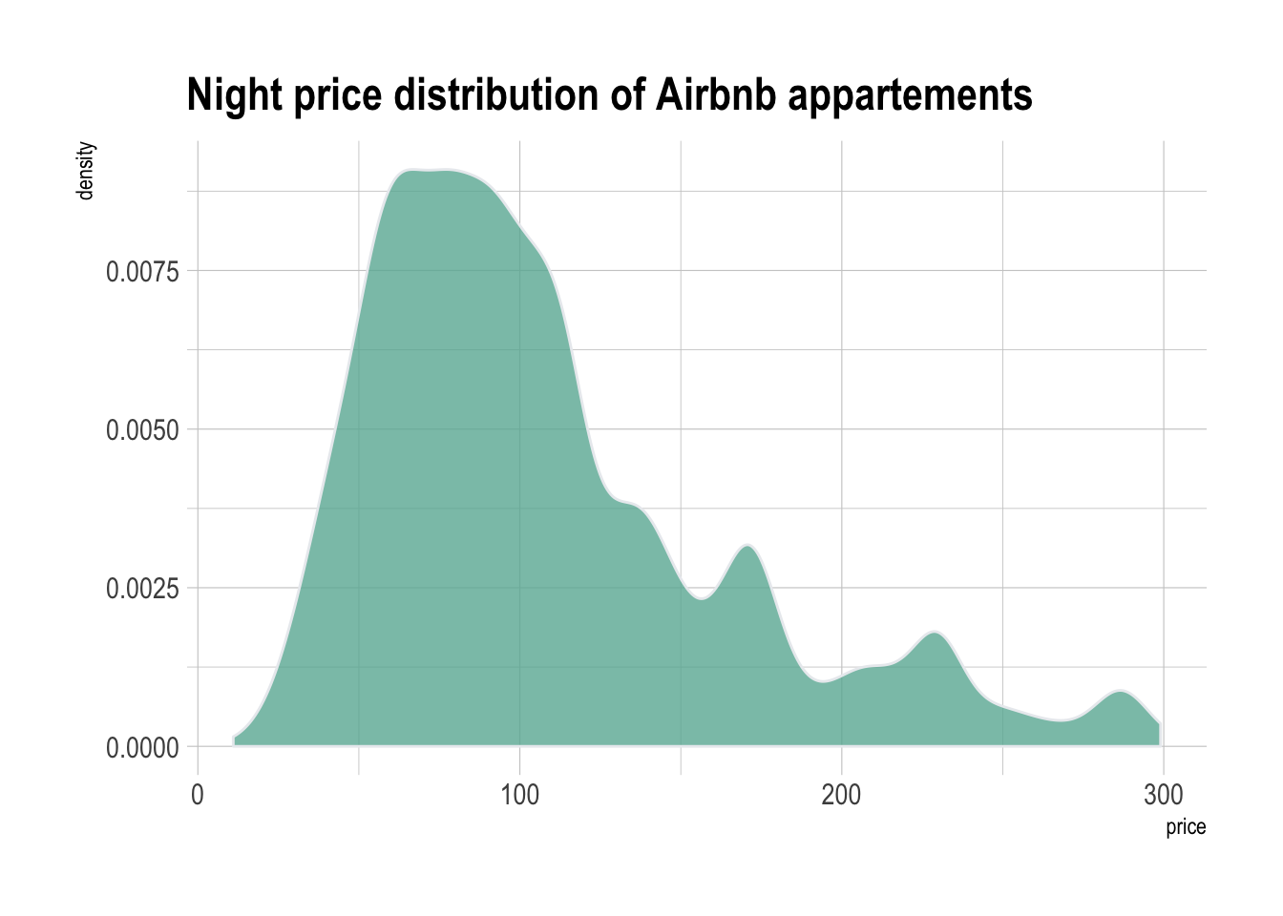
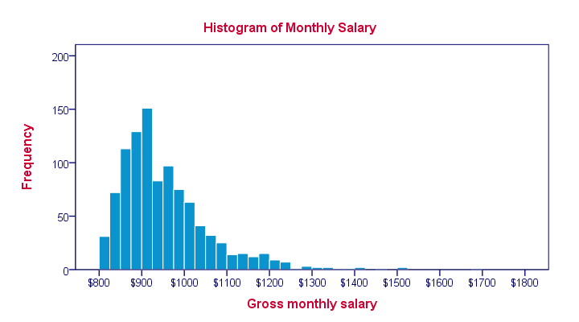
Histogram and density plot
ggplot(data = <DATA>, mapping = aes(<MAPPINGS>)) + geom_histogram()
ggplot(data = <DATA>, mapping = aes(<MAPPINGS>)) + geom_density()

Slide 9
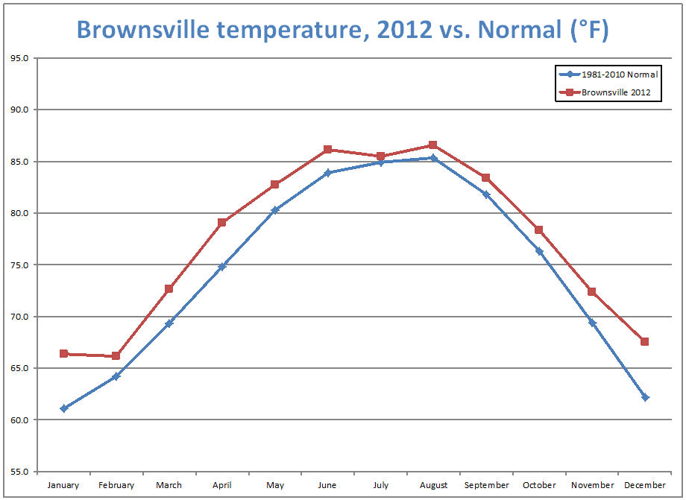
Line graph
ggplot(data = <DATA>, mapping = aes(<MAPPINGS>)) + geom_line()

Slide 10
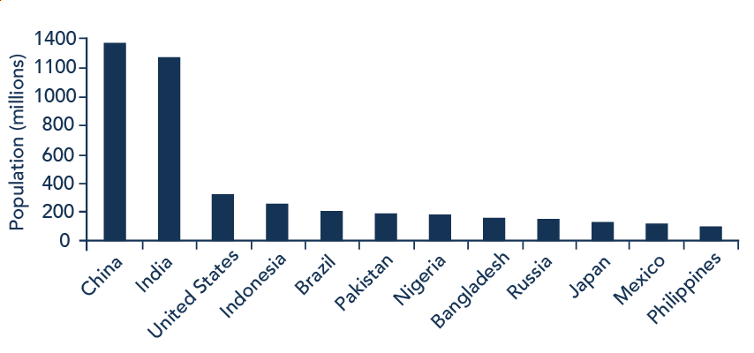
Bar graph
ggplot(data = <DATA>, mapping = aes(<MAPPINGS>)) + geom_bar()
ggplot(data = <DATA>, mapping = aes(<MAPPINGS>)) + geom_col()

Slide 11
Break

Slide 12
Additional resources
R graphics cookbook: https://r-graphics.org
R themes: https://ggplot2.tidyverse.org/reference/ggtheme.html
Stack overflow

